Slide 1
Welcome
Slide Presented By : Md. Asiful Haque 12201011
Md. Zahidul Islam 12201051

Slide 2
Feature
Store Information about Members, Staff.
Insert, modification of database from user interface.
Search Panel.
Package selection based on user Information as Height, Weight.

Slide 3
Future Work
BMI Calculator
DB Size
DB Audit System.
DBA System.

Slide 4
SQL Queries
SELECT column_name, aggregate_function(column_name) FROM table_name WHERE column_name operator value GROUP BY Column_name HAVING aggregate_function(column_name) operator value
SELECT column_name(s) FROM table_name ORDER BY column_name [ASC|DESC]
SELECT column_name(s) FROM table_name1 UNION SELECT column_name(s) FROM table_name2

Slide 5
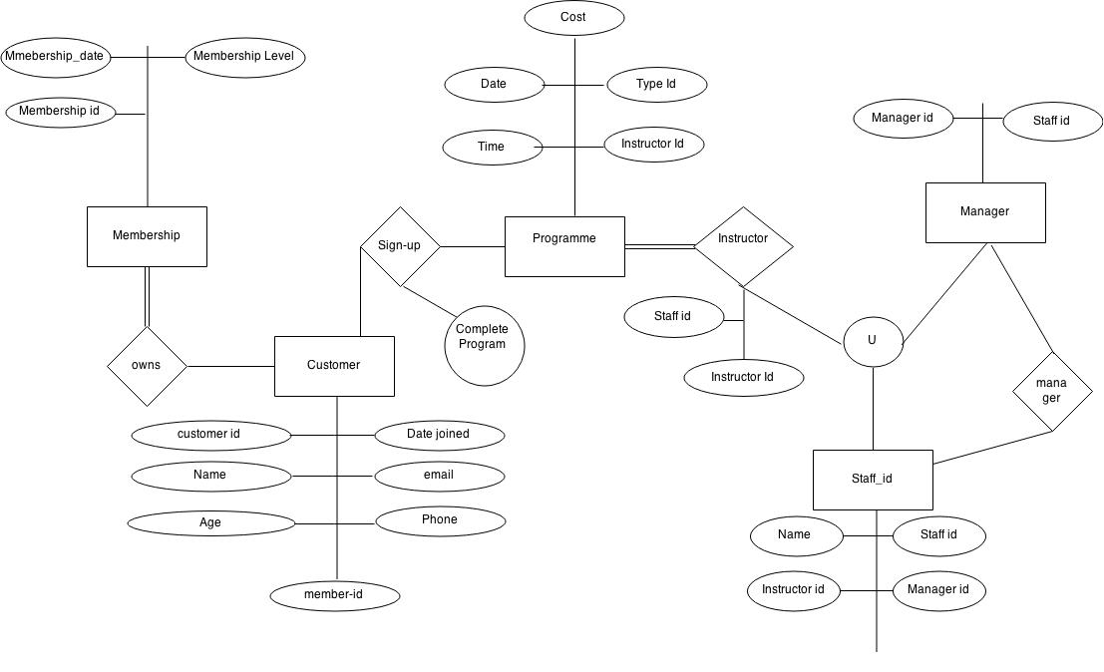
ER-Diagram

Slide 6
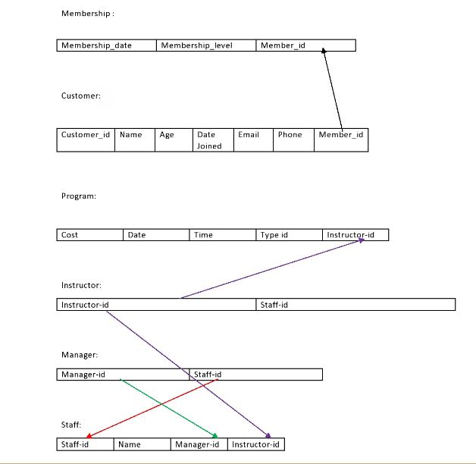
Schema

